Slide 1

_x0010_BALOO Training
Aims and Purposes

Slide 2
BALOO - Aims and Purposes
Learning Objectives
Learning Objectives
  Explain the Scope of this training.
  Describe the guidelines established by the National Council for this program.
  Describe the BSA progressive camping program and the importance of maintaining the steps.
  Explain the purposes of Cub Scouting and how they relate to this training.
  Explain the value of the outdoor program in promoting scouting values.

Slide 3

BALOO - Aims and Purposes
Scope of Training
Give an inexperienced leader the skills and confidence to venture into the great outdoors
  Health and Safety of participants
  Program Planning
  Very Few Basic Outdoor Skills
  Increase knowledge of BSA resources available
We want your first time camping experience to be a good one for you AND the cubs!

Slide 4

BALOO - Aims and Purposes
National Council Guidelines
Overnight camping by Tiger, Wolf and Bear Cub Scout dens -as a den - is not approved and certificates of liability insurance will not be provided by the Boy Scouts of America
Tiger Cubs may participate in boy-parent excursions, day camps, pack overnighters, or council-organized family camping.
Wolf and Bear Cub Scouts and Webelos Scouts may participate in a resident overnight camping program operating under BSA National Camping School-trained leadership and managed by the council.

Slide 5
BALOO - Aims and Purposes
National Council Guidelines
A Webelos Scout may participate in overnight den camping when supervised by an adult. In most cases, the Webelos Scout will be under the supervision of his parent or guardian. It is essential that each Webelos Scout be under the supervision of a parent-approved adult. Joint Webelos den-troop campouts including the parents of the Webelos Scouts are encouraged to strengthen ties between the pack and troop. Den leaders, pack leaders, and parents are expected to accompany the boys on approved trips.

Slide 6
BALOO - Aims and Purposes
National Council Guidelines
Camping activities take place in council-owned or managed facilities or council-approved developed sites such as national parks, state, county, and city camping parks, or council-approved, privately owned campgrounds. (See Appendix B Handout)
If a well-meaning leader brings along a child who does not meet these age guidelines, disservice is done to the unit because of distractions often caused by younger children. A disservice is also done to the child, who is not trained to participate in such an activity and who, as a nonmember of the group, may be ignored by the older campers.

Slide 7

BALOO - Aims and Purposes
BALOO Guidelines
KISMIF, emphasis on the F
Advancement is not the focus. Advancement opportunities will present themselves in an outdoor setting.
Follow Youth Protection policies.

Slide 8
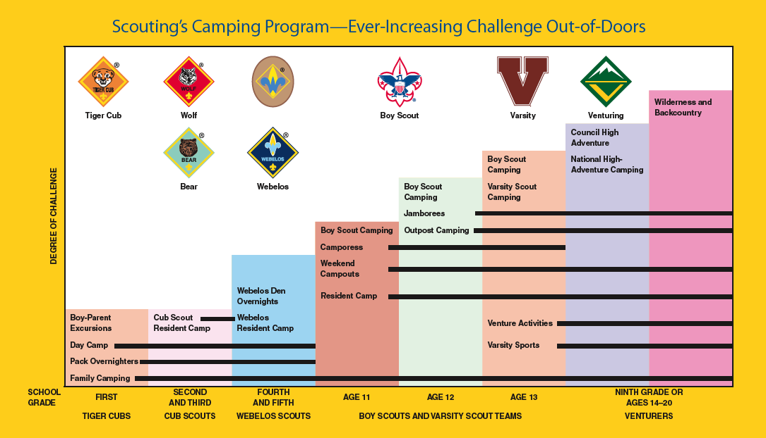
BALOO - Aims and Purposes
Describe Progressive Camping

Slide 9
BALOO - Aims and Purposes
Describe Progressive Camping
Each step in the ever-increasing challenge of the outdoor program is the foundation for the next higher step.
Four Levels of Camping for Cub Scouts
  Cub Scout Day Camp
    An organized one to five-day theme-oriented program conducted by the council or district. (NPD - HC Fairgrounds - Knights of the Roundtable)
  Cub Scout Resident Camp
    A council-organized, theme-oriented, overnight camping program. (Camp Oest - Olympic Adventure)
  Council-Organized Family Camps
    Council-organized family camps are activities involving more than one pack.
  Pack Overnighters
    Pack-organized overnight camping activities involving more than one family from the pack.
See Cub Scout Outdoor Program Guidelines for 2007-2008 (BSA #13-631)

Slide 10
BALOO - Aims and Purposes
Purposes of Cub Scouting
If advancement is not to be the focus of these pack camp activities, how do we know what type of activities to plan in our programs?
What kinds of enrichment do we, as parents and leaders, expect our Cub Scouts to come away from these activities with?
The Purposes of Cub Scouting
(See Appendix C Handout)

Slide 11
BALOO - Aims and Purposes
Purposes of Cub Scouting
Character Development
Spiritual Growth
Good Citizenship
Sportsmanship and Fitness
Family Understanding
Respectful Relationships
Personal Achievement
Friendly Service
Fun and Adventure
Preparation for Boy Scouts
Any activity that is a part of this pack camping experience should relate directly to one or more of the purposes of Cub Scouting.

Slide 12
BALOO - Aims and Purposes
Promoting Scouting Values
What are the values of the outdoor program?
The answer comes from the core values of scouting.
Citizenship
Compassion
Cooperation
Courage
Faith
Health and Fitness
Honesty
Perseverance
Positive Attitude
Resourcefulness
Respect
Responsibility

Slide 13
BALOO - Aims and Purposes
Review
Learning Objectives
  Explain the Scope of this training.
  Describe the guidelines established by the National Council for this program.
  Describe the BSA progressive camping program and the importance of maintaining the steps.
  Explain the purposes of Cub Scouting and how they relate to this training.
  Explain the value of the outdoor program in promoting scouting values.

Slide 14

BALOO - Aims and Purposes
Questions
Most (if not all) should be answered during the remaining training.
Do you have any questions concerning the Aims and Purposes?

Slide 15
BALOO Training
Aims and Purposes

